Slide 1

What Makes a National Football League Team Successful? an Analysis of Play by Play Data
Josef ur, Mathew craner, rehab el-hajj
a presentation by Jun Hanvey

Slide 2
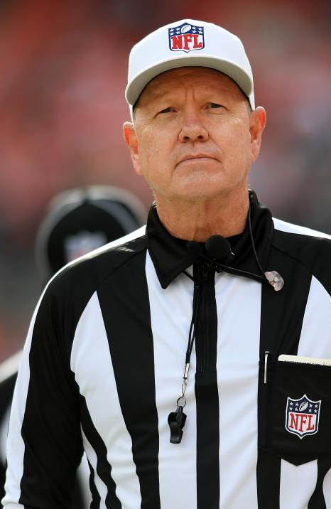
Background
In American football, the objective of the game is to advance the ball and score points.
Penalties (on the offense) prevent them from achieving this goal
How much of an effect do penalties have on team success?
My hypothesis is that penalties themselves do not make the difference between a win/loss, but that better teams commit less penalties.

Slide 3
abstract
The objective of this research was to isolate traits of successful NFL team using Naïve Bayes, association rules, and decision trees
This was done by classifying teams as a “top” or “bottom” team

Slide 4
methods
Decision tree analysis determines which variables are more likely to be associated with a certain outcome – in this case, a team being successful or not.
Association Rules is used to discover meaningful connections between variables, such as the frequency of an event happening inside of another event or the probability of two events occurring together.
Play by play data

Slide 5
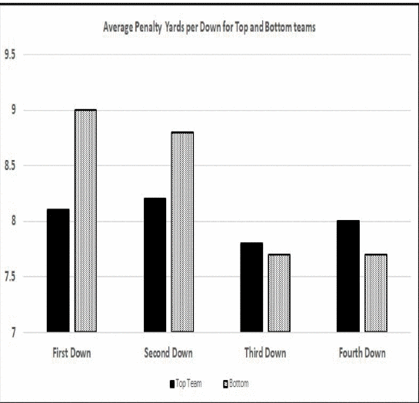
According to this chart, “top” teams lose less yards on first and second downs possibly contributing to their success.

Slide 6
Conclusion/results
The authors of this paper were not able to come to a conclusion regarding how penalties affect team success, besides from more successful teams being penalized more on early downs, thus giving them more time to regain that yardage.

Slide 7
Harbingers of foul Play: A field study of gain/loss frames and regulatory fit in the nfl
Written by Evan Polman, Lyn M. Van Swol, and Paul R. Homan
Behavioral economics
Published in “Judgement and Decision Making”

Slide 8
abstract
Do people cheat more when they have something to win or something to lose?
Regulatory fit: promotion vs. prevention focus
Gain/loss frames: describing a choice in terms of it’s positives or negatives
Offensive players foul more when their team is losing
Defensive players foul more when their team is winning

Slide 9
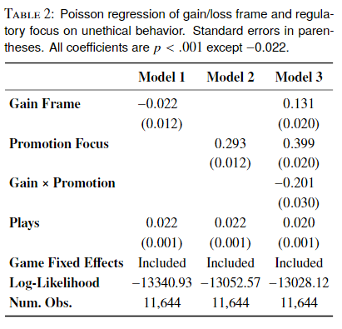
Methods
Play by play data from 2,917 games, with 473,899 plays
Poisson regression of gain/loss frame and regulatory focus, including fixed effects
Estimating the probability of a foul under certain conditions

Slide 10
results
Whether a player commits a penalty or not is correlated with his team’s position (leading or trailing).
This paper was more of a study on regulatory fit and gain/loss frames, using football as an example.

Slide 11
Next steps
How much of an influence do penalties have on a teams wins/losses?
So far, the literature I have found has not had a lot of information
Many papers that study game outcomes tend to focus on offense vs defense, or run plays vs pass plays. Penalties tend to be an afterthought.

Slide 12
questions
What connection did the first group of researchers find between penalties and successful teams?
1.
What variable were the authors of the second paper trying to predict?
2.
In the second paper, it is noted that offensive players are more likely to commit penalties when their team is losing. How might this finding relate to my research question?
3.

Slide 13
Works cited
J. Ur, M. Craner and R. El-Hajj, "What Makes a National Football League Team Successful? an Analysis of Play by Play Data," 2019 IEEE 10th Annual Ubiquitous Computing, Electronics & Mobile Communication Conference (UEMCON), New York, NY, USA, 2019, pp. 0419-0425, doi: 10.1109/UEMCON47517.2019.8993072. keywords: {Algorithms;Management;Measurement;Design;Experimental;Sport data Analysis},
Polman E, Van Swol LM, Hoban PR. Harbingers of foul play: A field study of gain/loss frames and regulatory fit in the NFL. Judgment and Decision Making. 2020;15(3):353. Accessed February 16, 2024. https://research-ebsco-com.proxy.li.suu.edu:2443/linkprocessor/plink?id=dbb3cdaf-c7f4-30cc-b61c-35b27b2da5c7

